Slide 1

Hobby Swap
“Rediscover the joy of sharing”

Slide 2






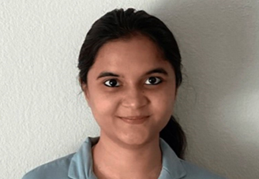
team mavericks
Roja Veerabasappa Nalwad
Zubair Shafiullah Khan
Ramanamurty
Kaushal Anurag Rajana
Sanjana Annu
Sriharsha
Sahith Varma Mudunoori

Slide 3



Issues with Skill development
Ageism Perception : Some older individuals may feel that younger users are more valued or favored while learning a skill.
Financial Constraints: Financial situations can hinder an individual's ability to acquire new skills or pursue their interests.
Geographic Limitations : Individuals miss opportunities for cross-cultural learning and skill acquisition, emphasizing the importance of finding innovative solutions like online platforms or virtual experiences to overcome these limitations.
Time Constraints: People with busy schedules, such as full-time workers, parents, or students, may find it difficult to allocate time and travel for skill exchange.
Language Barriers: Users may struggle to find matches or effectively communicate with potential skill swappers who speak a different language.
Team Mavericks – Hobby swap

Slide 4
Our Vision And Mission
VISION
MISSION
At Hobby Swap, our vision is to establish a vibrant and interconnected global community of lifelong learners and skill sharers. We aspire to create an inclusive digital space that transcends age, cultural boundaries, and professional backgrounds, empowering individuals to forge meaningful connections, share their expertise, and embark on transformative journeys of personal growth.
Hobby Swap empowers diverse individuals through collaborative learning on a dynamic platform. Our global mission connects people for the exchange of skills, experiences, and knowledge, fostering personal development. Introducing an innovative point system encourages a mutually beneficial environment, allowing users to earn and spend points for a thriving community. As we expand into adjacent markets, we stay attuned to evolving user needs, creating a pathway for continuous growth and opportunities.
Team Mavericks – Hobby swap

Slide 5
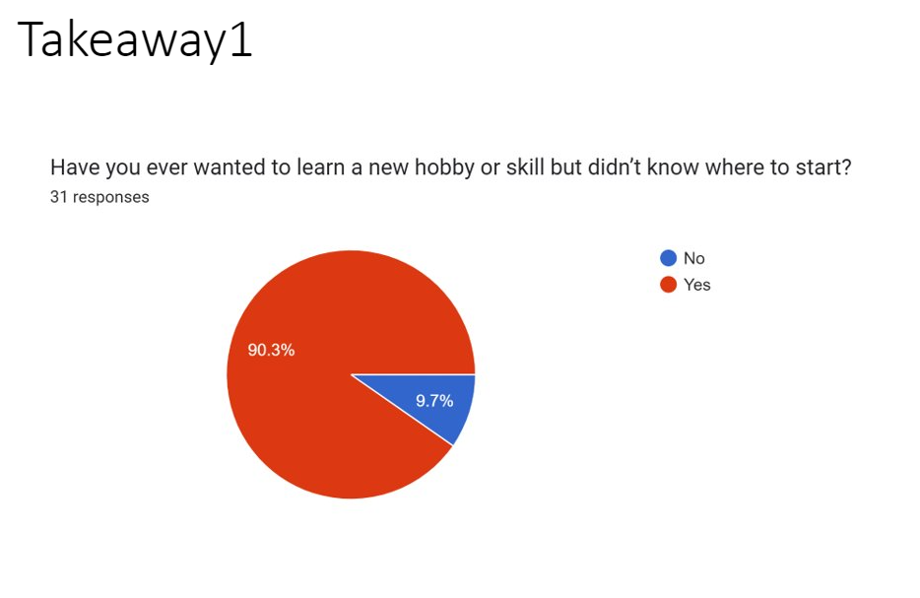
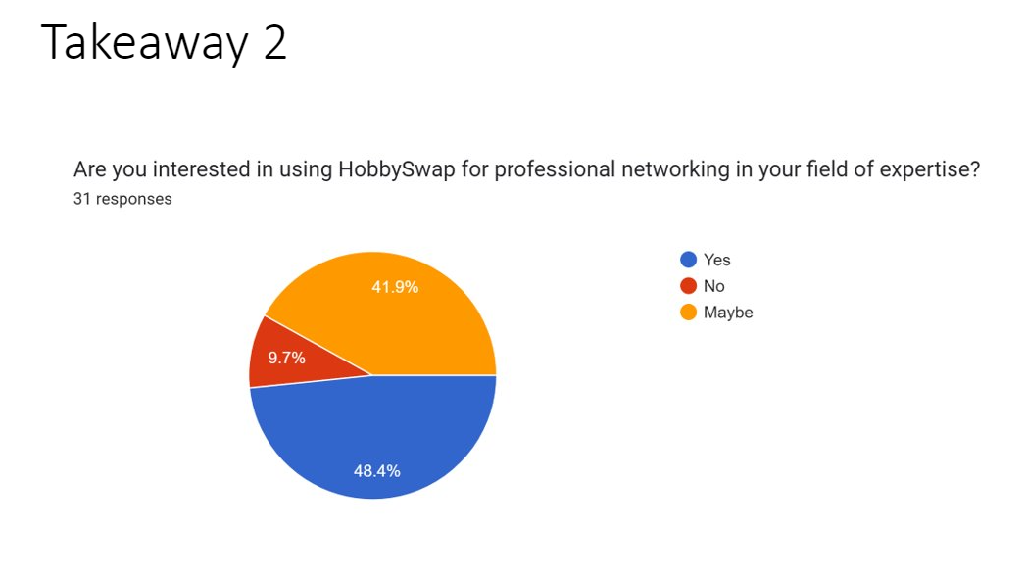
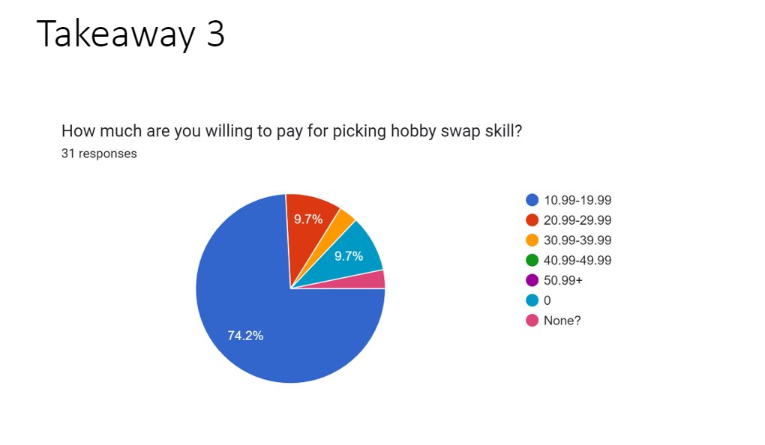
Key Takeaways
Over 90% of the survey respondents wanted to learn a new hobby/skill but didn’t know from where to start.
48.4% of the respondents said they were open to use Hobby swap for professional networking
Around 90% of the survey respondents were willing to pay for picking Hobby swap skill ,which indicates interest in using app and paying for services ,indicating customers see value in the app
Team Mavericks – Hobby swap

Slide 6
HOBBY SWAP ROADMAP
2024-Q1
User registration and social media integration
Hobby listings and search
Chatbot support
Blogging and Messaging
Q4
Pre-Launch
2024-Q2
Points Ratings and feedback
Matching Algo, Skill discovery and user verification
Ad Monetization
Mobile App (IOS & Android)
Q5
Product Launch
2024-Q3
Subscription model – Hobby Plus
Influencer partnerships
Gamified system to list badges and leaderboards
Language Translation
Q6
Team Mavericks – Hobby swap

Slide 7
HOBBY SWAP ROADMAP
2024-Q4
Events and works
Global Cultural Listing
Partnerships with cultural travel agencies
Data Insights and AI
Q4
Growth & New Markets
2025-Q1
Events and workshops
Partnerships with corporates and educational Institution
Skill podcasting
In-app Marketplace
Q5
Market Expansion
2025-Q2
Enhancement of AI engine for search
VR Hobby
Global Classroom
Co-working spaces
Q6
Team Mavericks – Hobby swap

Slide 8




Innovation
Skill Fest: Elevate your expertise at our Skill Events.
In App Marketplace: A marketplace for users to sell physical items related to their skills, with Hobby Swap taking a commission.
Skill Matching Algorithm: Creating a system that intelligently connects users based on their skills, preferences, and learning styles.
Global Craft: Explore global hobbies and cultural hobbies from different locations of the world.

Slide 9

Disruptive Innovation
Language Translator: Break down language barriers and foster cross-cultural understanding with real-time text and voice translation. Converse seamlessly with users from diverse backgrounds, expanding your global network and knowledge base.
Co-working Integration: Tap into a network of collaborative workspaces around the world, equipped for creativity, teamwork, and skill development. Engage in hands-on learning opportunities, surrounded by like-minded individuals and resources.
Skillful Journeys: Embark on transformative journeys that combine exploration with expertise through our "Skillful Journeys" program. Immerse yourself in the heart of a new culture, delving into a specific hobby, art, or craft unique to the destination.
Team Mavericks – Hobby swap

Slide 10

Stickiness
Language Translation Integration
In-App Marketplace
Skillful Travel Plan
Integration with co-working space
Team Mavericks – Hobby swap

Slide 11
Value Creation
Users
Partnerships and Collaborations
Employee
Promotes Culture travelling
Diverse Hobby Options
Ease of use
Cost savings for Hobby development
Community Engagement and Networking for Extracurricular activities
Innovation Support
Training and development
Recognition and Rewards
Free Travel related guidance
Visibility and Promotion
Business Opportunities
Local Markets expansion
Collaboration and Networking
Team Mavericks – Hobby swap

Slide 12
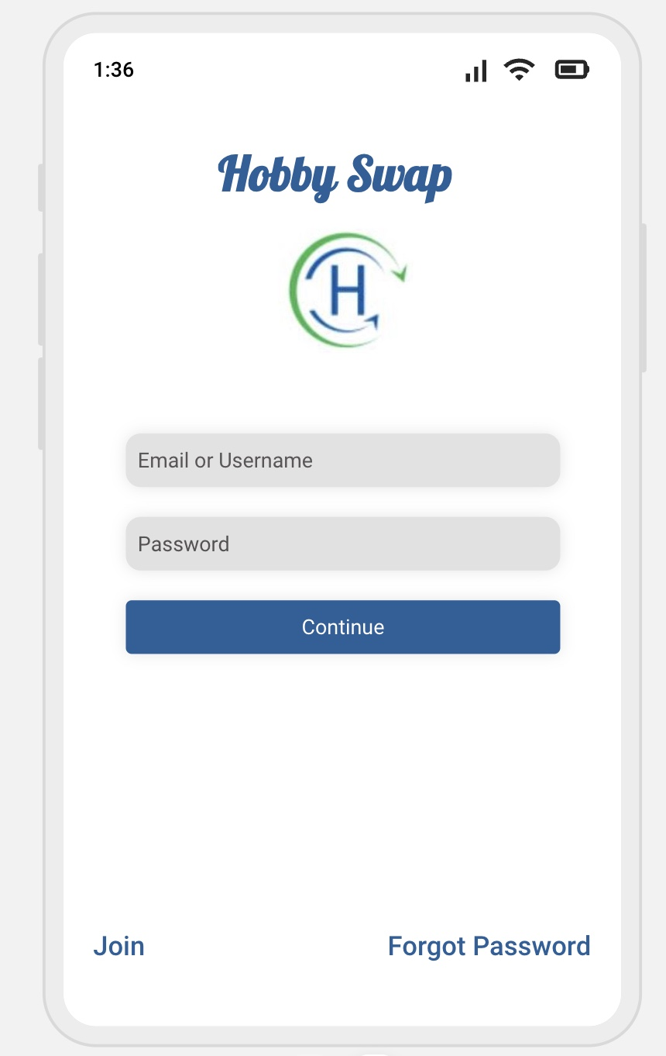
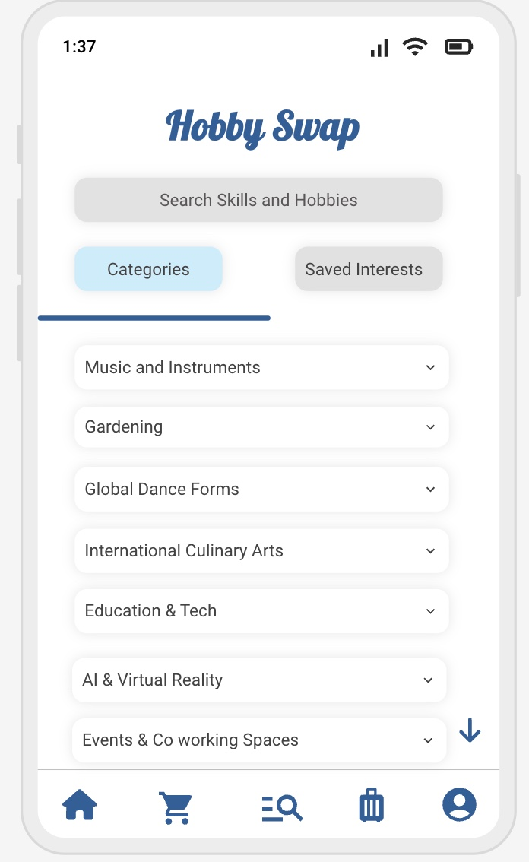
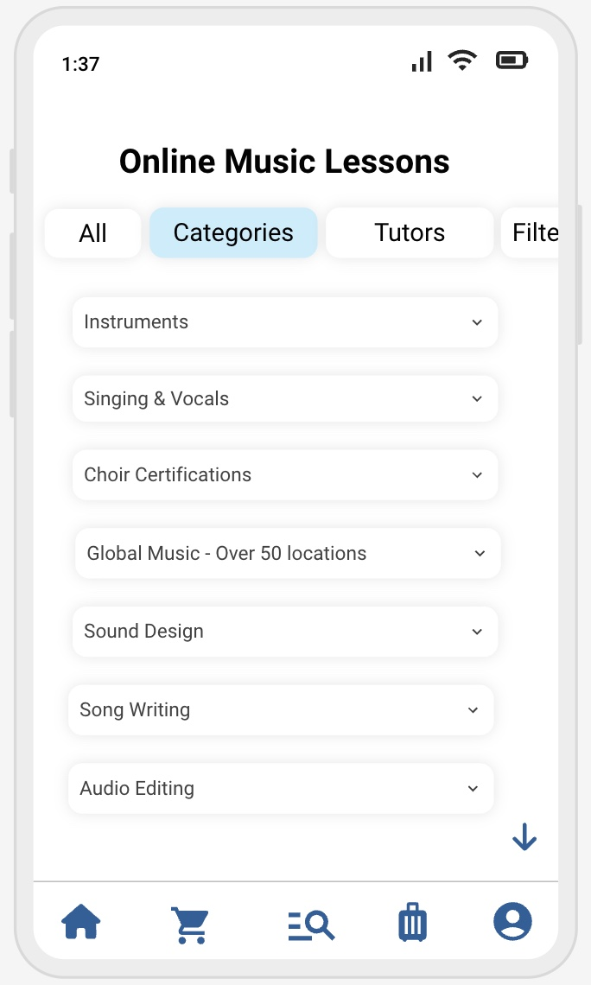
Proposed User Interface
Team Mavericks – Hobby swap

Slide 13
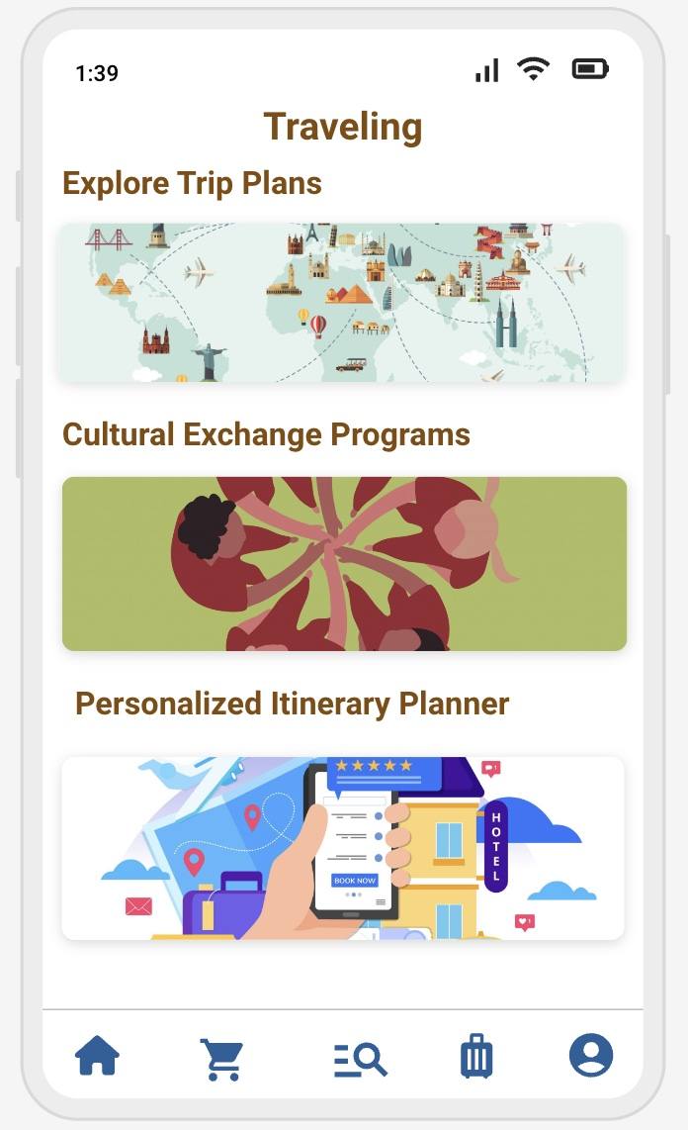
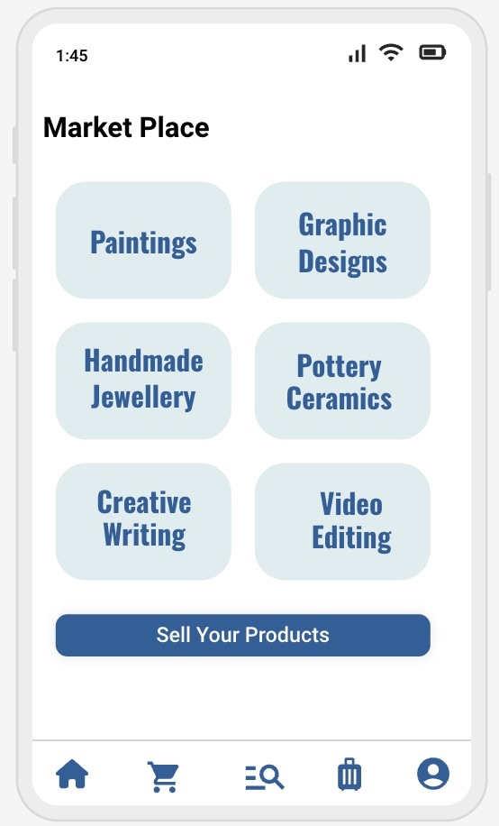
Proposed User Interface
Team Mavericks – Hobby swap

Slide 14





Existing market
In-App Marketplace
Events Market
Free lance Services
Etsy
Depop
eBay
Facebook marketplace
Mercari
Bonanza
Amazon
Eventbrite
Meetup
Upwork
Fiverr
Freelancer
Team Mavericks – Hobby swap

Slide 15

New market
White label Markets
Cultural Travel Programs
Global Skillset services
Youth and Education focus
Partnerships with heritage organizations
Team Mavericks – Hobby swap

Slide 16
Adjacent market
Travel Agencies and Insurance
Hotels
Various Events and workshops
Partnership with VR companies for Immersive cultural experience
Affiliate Link sharing from Influencers
Team Mavericks – Hobby swap

Slide 17
Exponential growth
Hobby meetups
Alliance with International influencers
Global markets expansion
International Coporate events
International cultural experience packages for similar Hobby enthusiast
Team Mavericks – Hobby swap

Slide 18
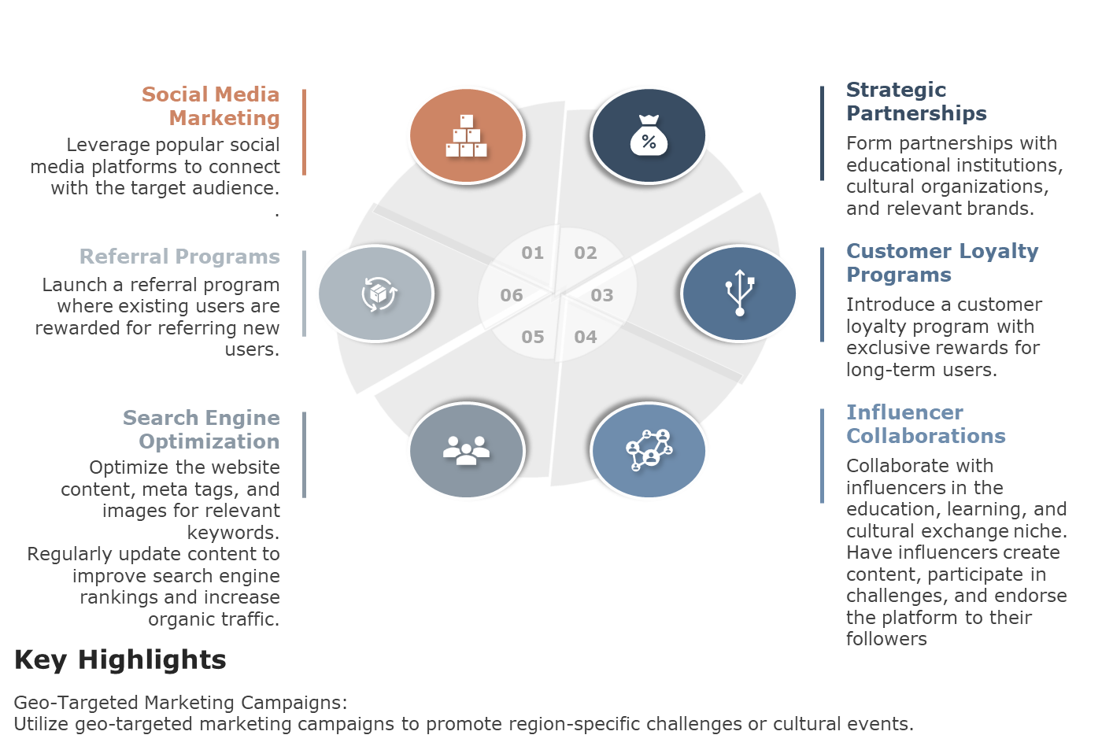
Market Strategy
Team Mavericks – Hobby swap

Slide 19
Business Model
Freemium:
Standard:
Premium:
Freemium: Hobby Swap Free Skill Access: Access to a limited number of basic skills and challenges across various categories.
Community Participation: Full access to community forums, groups, and basic user engagement features.
Ad-Supported: Experience the platform with occasional unintrusive ads.
Standard: Hobby Swap Standard (Subscription-10$/month) Skill Access: Full access to a diverse range of skills and challenges across all categories.
Community Participation: Join specialized interest groups, forums, and engage in community challenges.
Ad-Free Experience: Enjoy the platform without any advertisements.
Premium: Hobby Swap Premium (Subscription-20$/month) Skill Access: Exclusive access to premium-level skills and challenges curated by experts.
Community Participation: Access to premium forums and groups for in- depth discussions.
Ad-Free Experience: Enjoy the platform without any advertisements.
Team Mavericks – Hobby swap

Slide 20
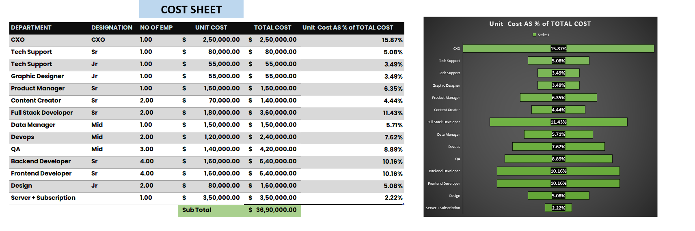
Cost sheet

Slide 21
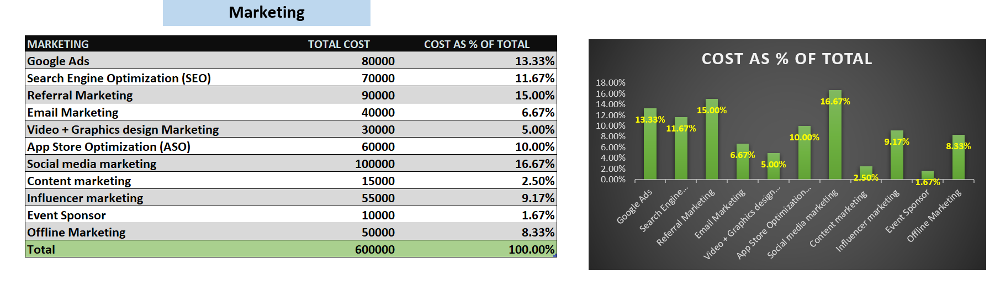
Marketing costs

Slide 22
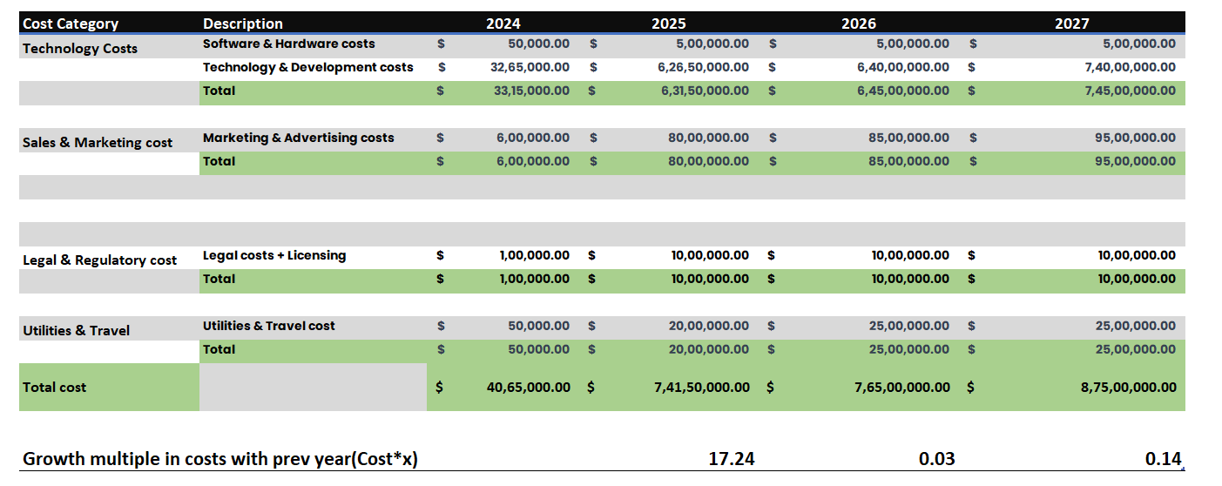
Cost Sheet 2024-2027

Slide 23
Revenue in the Toys & Hobby Market is projected to reach US$120.20bn in 2023, 80% of the activity is
offline while only 20% is online, Revenue is expected to show an annual growth rate (CAGR 2023-2028) of 8.58%
Cultural Tourism market generated a revenue of $5321.7 in 2022 and is expected to generate 11900 million by
2029 with CAGR of 14.4%
In the Toys & Hobby Market, the number of users is expected to amount to 763.0M users by 2028.
The average revenue per user (ARPU) is expected to amount to US$246.20 globally, while in US it is $1150
In US we have 28m users ,assuming we 20% of users are online user and our Platform will get 5% of market share
(5% of 20% of total users who are online) i.e., 280k users in US
Assuming we have 500m users in the market globally, & 20% users are online users, and capturing 5% of the
users to our platform i.e., (5% of 20% of total users who are online) 5m users globally.
Revenue assumptions

Slide 24
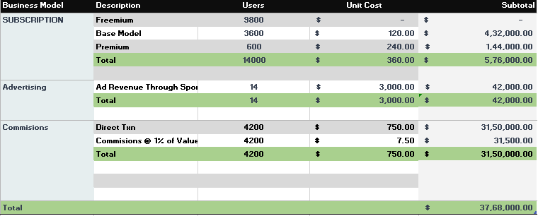
Assumptions
First Year operations is in US (5% of 280k users in US to be captured) ,assuming 30% pay for subscription services (early adopters).
Advertising - Opening a sponsored ad slot for every 1000 impressions
Commission of 1% of total order value, assuming 30% of total 14k users do transaction and average ARPU of $750(US has avg ARPU of 1150) we get revenue from both these streams.
Revenue 2024

Slide 25
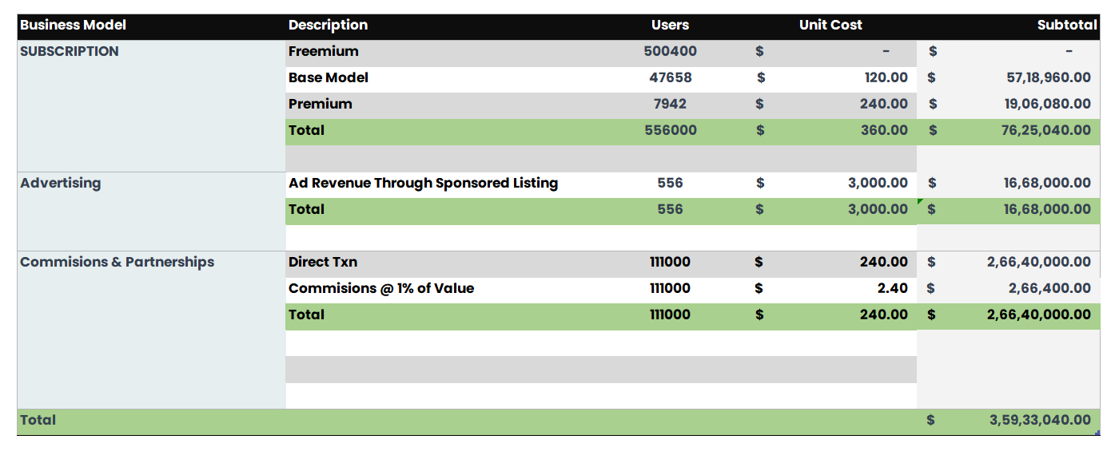
Assumptions
Second Year operation is in US (20% of 280K to be captured) and globally (10% of 5m users to be captured),assuming 10% pay for subscription services.
Advertising -Opening a sponsored ad slot for every 1000 impressions
We are taking commission of 1% of total order value, assuming 20% of total 556k users do transaction and average ARPU of 240 we get revenue from both these streams
Revenue 2025

Slide 26
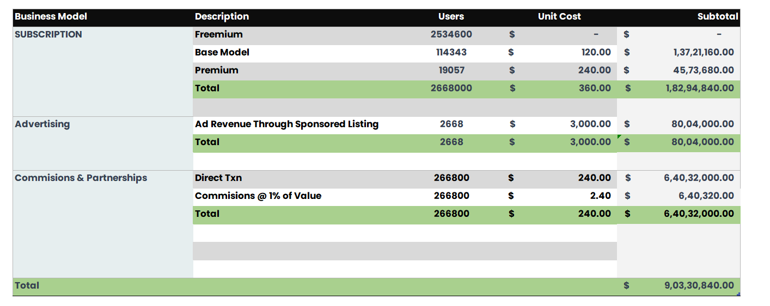
Assumptions
Third Year operation is in US(60% of 280k to be captured) & at global level(50% of 5m users to be captured),assuming 5% pay for subscription services as early adopters are already tapped.
Advertising -Opening a sponsored ad slot for every 1000 impressions
We are taking commission of 1% of total order value, assuming 10% of total 2.668m users do transaction and average ARPU of 240 we get revenue from both these streams
Revenue 2026

Slide 27
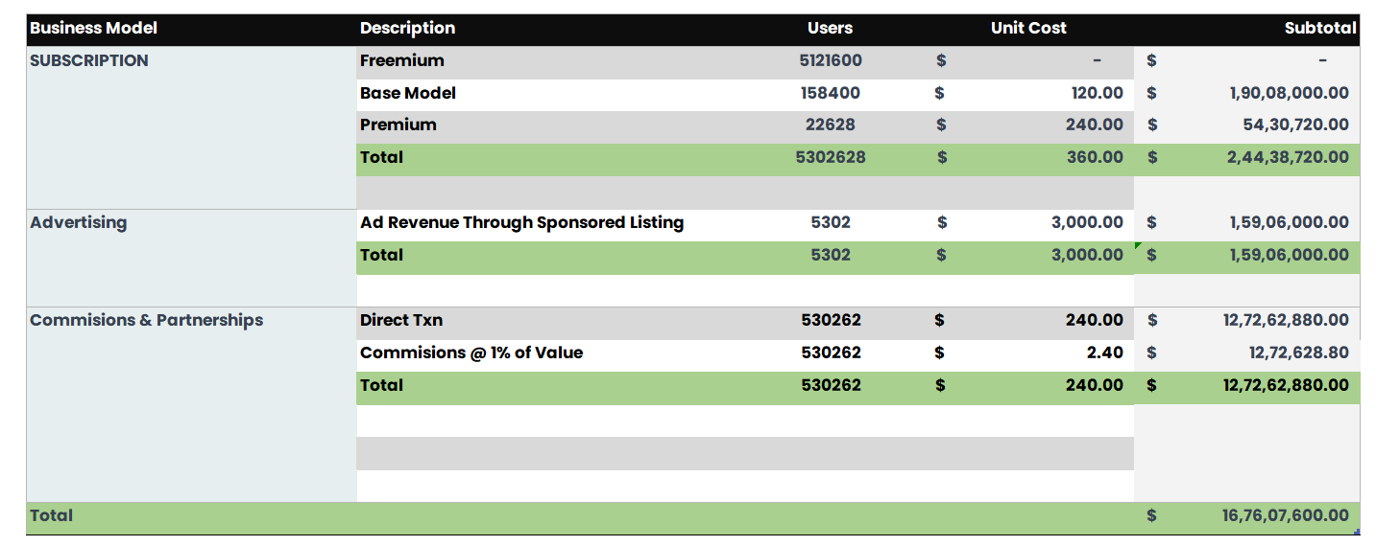
Assumptions
Fourth Year operation in US & at global level(5% of market share to be captured) ,assuming 3% pay for subscription services as early adopters are already tapped & market is getting matured.
Advertising -Opening sponsored ad slots for every 1000 impressions
We are taking commission of 1% of total order value, assuming 10% of total 5.30m users do transaction and average ARPU of 240 we get revenue from both these streams
Revenue 2027

Slide 28
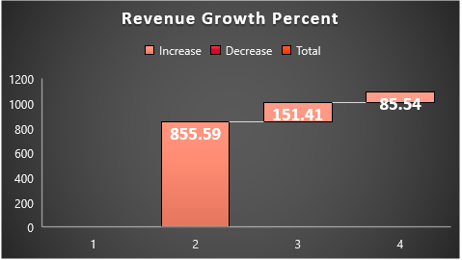
Summary of Revenue

Slide 29
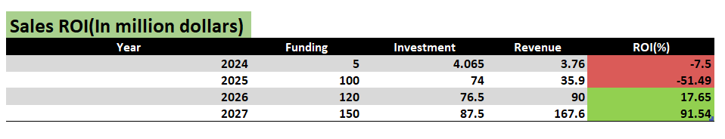
Sales roi

Slide 30
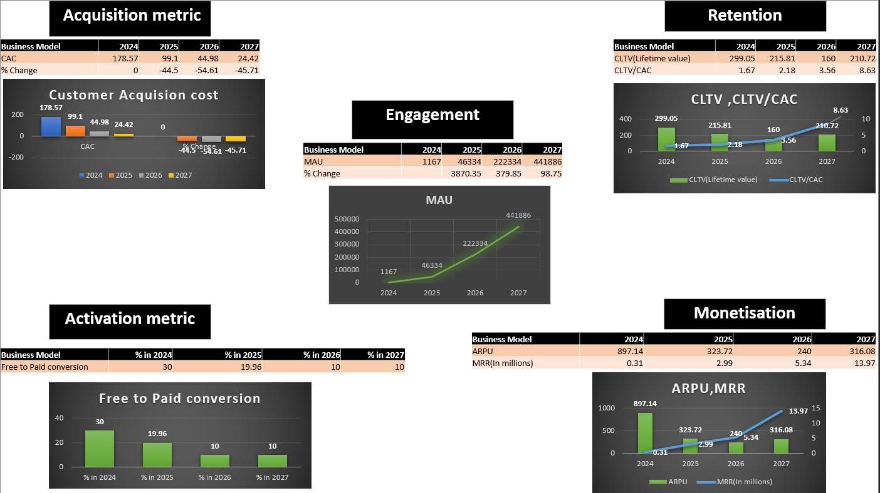
PRODUCT METRICS

Slide 31
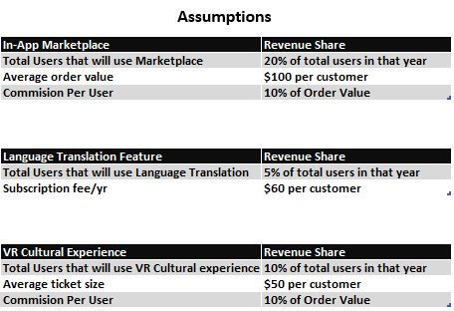
Costs
- Background check for listed service providers(Ops cost)
- VR Technology
- Customer Care
- Platform & Technology costs
Global AOV is $113
Limit of 5 times usage in a month after that people need to purchase
Aftermarket model

Slide 32
THANKYOU
- TEAM MAVERICKS PROJECT B – Foundations of Digital Project Management Professor Vansant Gondhalekar

